Slide 1
16010123214 Om Anand Jha
16010123215 Om Bhanushali
16010123216 Om Lanke
16010123217 Om Thanage
16010123218 Omik Acharya
16010123219 Omkar Dinde
16010123220 Omkar Desai

Slide 2
Introduction
Our project utilizes IoT technology, ultrasonic sound, and TDS sensors, all integrated with an ESP32 microcontroller.
It aims to provide a comprehensive solution for monitoring water levels and assessing water quality in real-time.
The system offers cost-effective and efficient water management, detecting issues such as water quality problems and potential leaks.
It addresses global concerns about water scarcity and quality while ensuring scalability and adaptability through IoT technology.

Slide 3





Problems
Inaccurate Water Level Monitoring | Limited Water Quality Assessment | Manual Data Collection
Resource Wastage |  | Data Accessibility

Slide 4

SOLUTION

Slide 5


Slide 6
Components
TDS Sensor
DS18B20WP
HC-SR04
ESP32
Other things

Slide 7
Components
TDS Sensor
DS18B20WP
HC-SR04
ESP32
Other things

Slide 8
Components
TDS Sensor
DS18B20WP
HC-SR04
ESP32
Other things

Slide 9
Components
TDS Sensor
DS18B20WP
HC-SR04
ESP32
Other things

Slide 10
Components
TDS Sensor
DS18B20WP
HC-SR04
ESP32
Other things

Slide 11
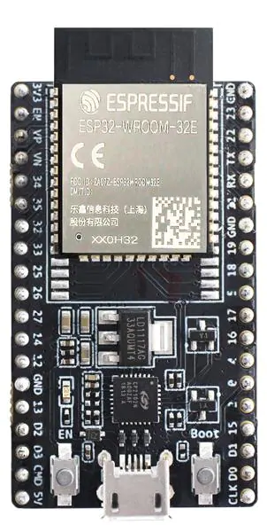

SENSOR
Water Input
PROCCESSING UNIT
ESP32
Length of water tank
WATER
TDS SENSOR
DS18B20WP
Water Outlet

Slide 12
How it’s measured?

Slide 13
WATER availability
The HC-SR04 ultrasonic sensor measures distance using sound waves. It emits a pulse, listens for the echo, and calculates distance based on the time it takes.

Slide 14
Hardness
A TDS sensor with probes measures dissolved solids in a liquid. It uses electrical conductivity between probes. More solids mean better conductivity. Resistance is measured and converted to a TDS value, usually in ppm or mg/L.

Slide 15
Temperature
The DS18B20WP is a waterproof digital temperature sensor. It communicates with a ESP32 using a single-wire protocol. Each sensor has a unique 64-bit address. It can be powered parasitically or externally. After a temperature conversion command, it measures temperature and sends a 12-bit digital value to the ESP32. The sensor's range is -55°C to +125°C. It employs CRC checks for data integrity.

Slide 16
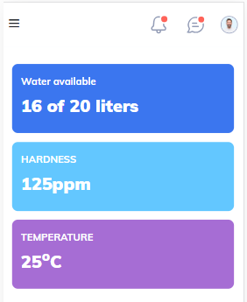
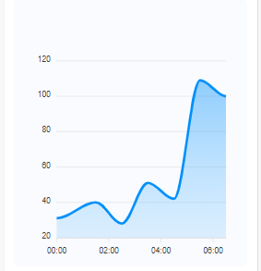
OUTPUT

Slide 17
Cost

Slide 18


